Slide 1
Understanding MTSS
Sharon Hizer, Intervention Teacher

Slide 2
What is MTSS?
Multi-Tiered System of Supports, or MTSS, helps teachers quickly identify student needs and the best methods to address them. These can be needs of individual students or groups of students, related academics, behavior or both. The idea is to get each and every student - those with profound needs, those who are exceptionally gifted and all those in between - what he or she requires to be successful.

Slide 3
Why MTSS?
It will make all students more successful in school and on track for graduation, while preparing them to be college or career ready. MTSS has been implemented and proven effective in districts across the country. As independent study released in January 2015, for example, found that “Kansas MTSS is substantially contributing to improved student outcomes at the local level, as well as benefiting teachers, improving instruction, and supporting better school functioning.”

Slide 4
How MTSS works
MTSS has three levels, or tiers, of instruction and support, all aimed at giving teachers a streamlined way to provide the best instruction to all students.
TIER 1 Includes the instruction and support provided to all children.
TIER 2 Serves students needing more help. Extra instruction and support often are provided to these children in small groups.
TIER 3 Is for children who need intense support in order to succeed. Extra instruction and support are provided, often in even smaller groups or one-on-one.

Slide 5
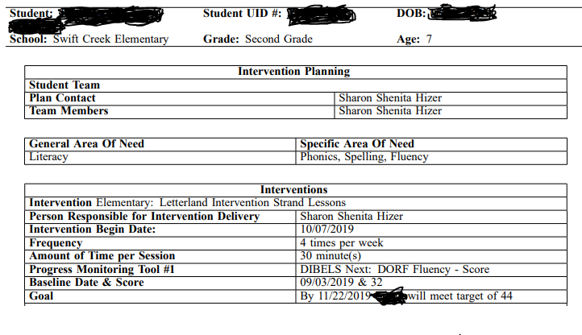
What is a Tier Plan?

Slide 6
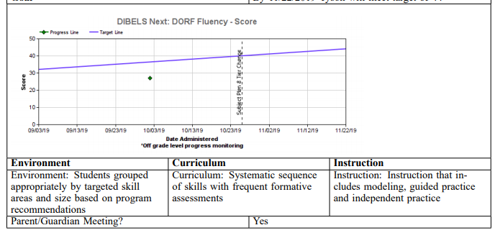
Tier Plan

Slide 7
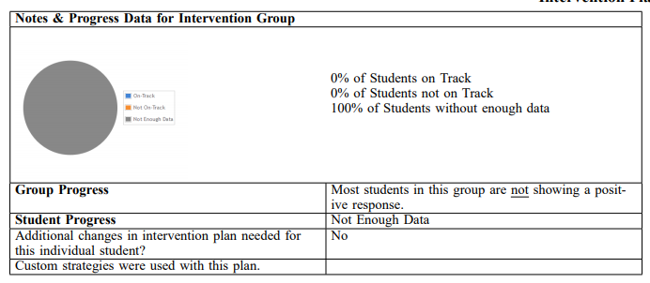
Tier Plan

Slide 8
What MTSS means for you and your child?
One of the keys to the success of MTSS is developing strategies that are effective for a particular student. Parents are an essential part of that equation. You know your child’s interests and strengths and also know interventions tried in the past, those that worked and those that didn’t. MTSS encourages teachers and parents to effectively communicate, collaborate, and problem solve using data to best meet the needs of your child.

Slide 9
Tips for Parents
Get to know your child’s teacher and actively participate with them in problem-solving discussions.
Communicate your child’s interest, strengths, and weaknesses.
If your child is receiving a Tier II or Tier III behavior intervention, ask school staff what academic or behavioral area is being addressed and how your child’s progress is being monitored.
Ask what you can do to be a part of the solution.
Suggest strategies and interventions based on what you know works at home.
Ask when the school will update you on results of the intervention.
Praise your child for any improvement in the area of concern.

